Slide 1
CNN Architectures and Object Detection
Prof. Sushree S. Behera
IIIT Bangalore

Slide 2
Agenda
Fundamentals of Object Detection
Classification vs. Localization vs. Detection
Object Detection Approaches (Machine Learning vs. Deep Learning)
CNN Architectures
Convolutional Layer
Pooling and Fully-connected Layers
Transfer Learning
Intuition Behind Why CNNs Work Well
Object Detection Approaches
Region-Based Detectors
One-Shot Detectors

Slide 3
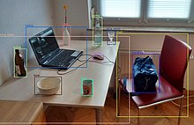
Object Detection
Identifying and locating objects within an image or video
https://www.google.com/
Notes:
Object detection involves identifying and locating objects within an image or video. It has applications in many areas of computer vision, such as face detection, image retrieval, object tracking, and video surveillance.

Slide 4
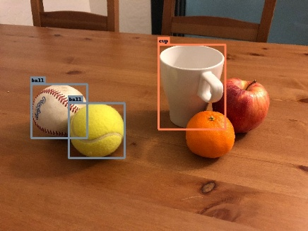
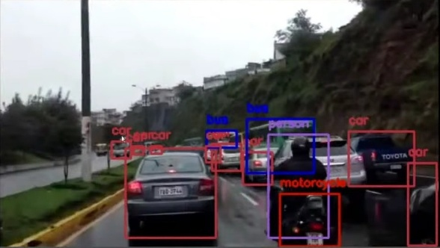
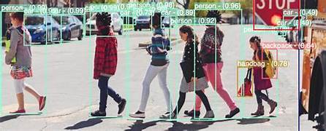
Object Detection
Which objects are present?
Where are these objects situated?
https://www.google.com/
Notes:
Object detection primarily aims to answer two critical questions about any image: "Which objects are present?" and "Where are these objects situated?" The output from an object detector is in the form of annotated images with bounding boxes around detected objects and labels indicating the identified objects.

Slide 5
Object Detection
Classification
Localization
Detection
assigns a label to an entire image
identifies the object and
determines the exact location
both object classification and localization
https://www.google.com/
Notes:
Object detection involves both object classification and localization. Image classification assigns a label to an entire image based on its content. While it's a crucial step in understanding visual data, it doesn't provide information about the object's location within the image. The process of identifying the object and determining the exact location of each identified object within the image by drawing bounding boxes around them is called image localization.

Slide 6
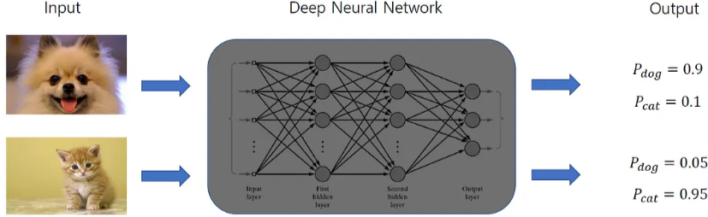
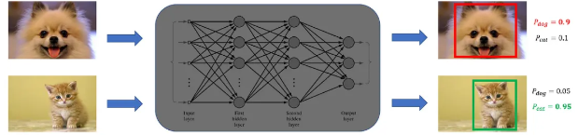

Object Detection
Classification
Detection
$$[x,y,h,w]$$
Classification
and regression
https://medium.com/ml-research-lab/what-is-object-detection-51f9d872ece7
Notes:
Object detection merges image classification and localization. It detects multiple objects in an image, assigns labels to them, and provides their locations through bounding boxes. In general, object detection can be thought as a problem in which a model performs image classification along with a regression task that predicts the position of an object using a bounding box.

Slide 7
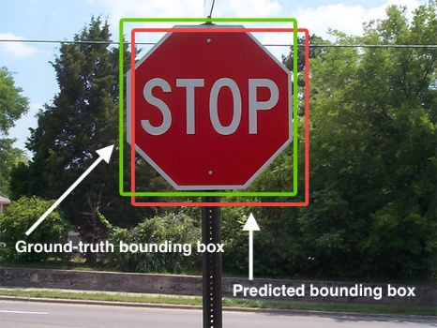
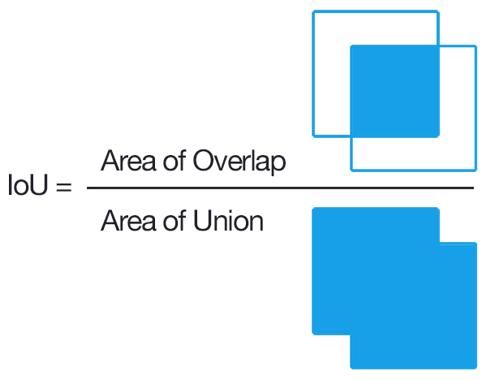
Object Detection: Evaluation Criteria
https://en.wikipedia.org/wiki/Object_detection
Notes:
The metric intersection over union (IoU) measures the overlap between the predicted bounding box and the ground truth bounding box. It is calculated as the area of overlap or intersection divided by the area of union. The value of IoU range from 0 to 1. An object detector has detected the traffic sign (a true positive) at a threshold of 0.5 if and only if it has drawn a bounding box whose IoU with the ground truth is above 0.5

Slide 8
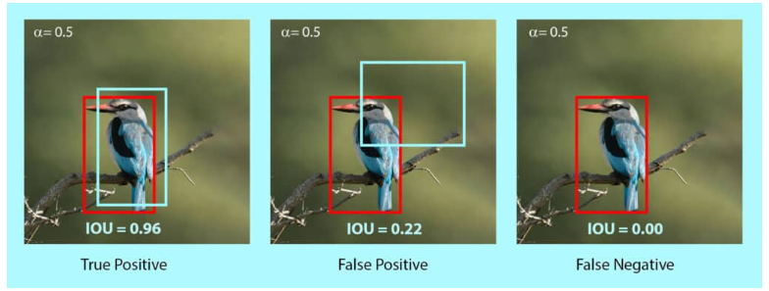


Object Detection: Evaluation Criteria
Precision $\frac{TP}{TP+FP}=\frac{TP}{Total predictions}$
Recall $\frac{TP}{TP+FN}=\frac{TP}{Total ground truths}$
https://learnopencv.com/mean-average-precision-map-object-detection-model-evaluation-metric/
Notes:
True Positive (TP) is correct detection made by the model, False Positive (FP) is Incorrect detection made by the detector, False Negative (FN) is when a Ground-truth missed (not detected) by the object detector. For simultaneous object localization and classification (i.e. object detection), a true positive is one where the class label is correct, and the bounding box has an IoU exceeding the threshold.

Slide 9
Object Detection: Evaluation Criteria
AP: Area under the precision-recall curve as the IoU threshold is varied.
mAP: Average of AP over all classes and IoU thresholds.
https://www.google.com/
Notes:
Simultaneous object localization and classification is benchmarked by the mean average precision (mAP). This metric evaluates the average precision across all classes and IoU thresholds. The average precision (AP) of the network for a class of objects is the area under the precision-recall curve as the IoU threshold is varied. The mAP is the average of AP over all classes.

Slide 10
Object Detection Approaches
Machine learning-based Approach
Manual feature extraction using pre-defined algorithms
Task specific, limited generalization
Less computationally expensive and data dependent
Deep-learning-based Approach
Features are automatically learned
Better generalization, allows transfer learning
More computationally intensive and data driven
Notes:
Methods for object detection can be categorized into traditional (or machine learning-based) and deep learning-based approaches. Similar to image classification problem, for machine learning-based approaches, it becomes necessary to first extract features. The relevant features are extracted manually from images using techniques like SIFT, or HOG. Out of those features, the most informative features are selected based on feature selection techniques. Then techniques such as support vector machine (SVM) for predictive modeling. On the other hand, in deep learning-based approaches, suitable features are automatically learned by the CNN during training. These techniques are able to do end-to-end object detection without specifically defining features, and are typically based on convolutional neural networks (CNNs).

Slide 11
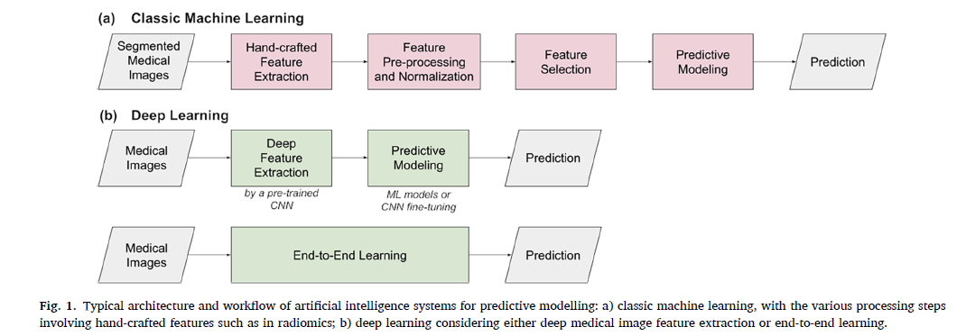
Object Detection Approaches
Notes:
Object detection frameworks based on deep learning techniques can involve, feature extraction followed by predictive modelling and end-to-end training. Features can be extracted by a pre-trained CNNs, typically termed as transfer learning, a technique that we will discuss in detail in later slides. For predictive modelling, we can use machine learning models like SVM or feed forward neural networks with classifiers or regressors.

Slide 12
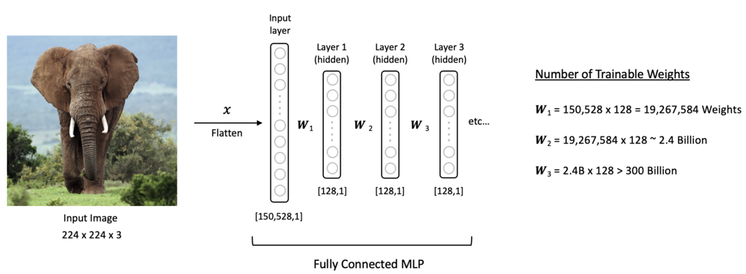
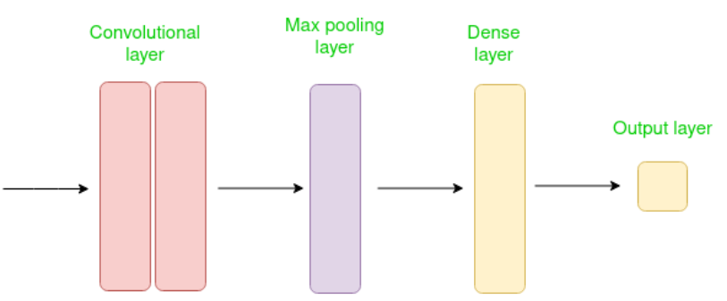
Convolutional Neural Networks
Designed to work with grid-structured inputs, with strong spatial dependencies in local regions.
https://learnopencv.com/understanding-convolutional-neural-networks-cnn/
https://www.geeksforgeeks.org/introduction-convolution-neural-network/
Notes:
Another major difference is that in a fully connected neural net, the output of every neuron in a layer is directly fed into the input of every neuron in the next layer. By contrast, in a CNN the input to every layer is a single value, determined by the convolution over a spatial neighborhood in the output of the previous layer.

Slide 13

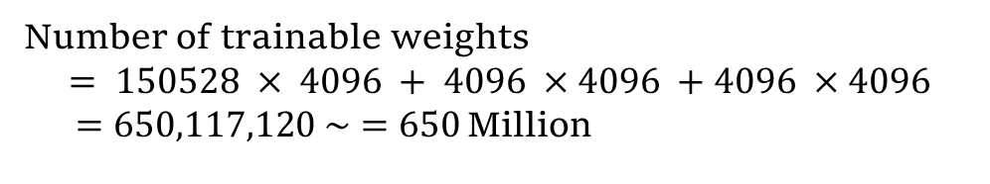
Convolutional Neural Networks
Number of trainable weights
$$= 150528 × 4096 + 4096 ×4096 +4096 ×4096$$
$=650,117,120 \sim =650$Million
$$150528 × 4096 + 4096 ×4096=633,339,904$$
https://learnopencv.com/understanding-convolutional-neural-networks-cnn/
Notes:
The basic difference between a CNN and the multi-layer FFNs is that inputs to CNNs are 2-D arrays (images), while inputs to our fully connected neural networks are vectors.

Slide 14
Convolutional Neural Networks
Hierarchical feature extraction
https://learnopencv.com/understanding-convolutional-neural-networks-cnn/
https://www.geeksforgeeks.org/introduction-convolution-neural-network/
Notes:
The crucial advantage of CNN is that it can learn its own image features from raw image data in a hierarchical manner.

Slide 15
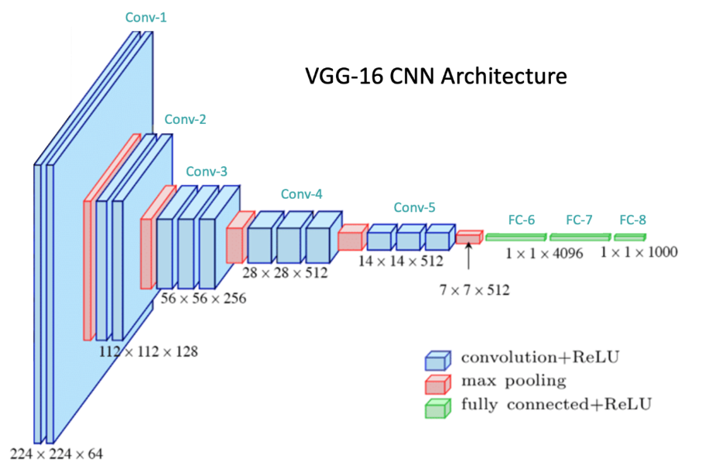
Convolutional Neural Networks
n_filters * Dim_filter * n_channel
https://learnopencv.com/understanding-convolutional-neural-networks-cnn/
https://cs231n.github.io/convolutional-networks/#conv

Slide 16
Convolutional Neural Networks
n_filters * Dim_filter * n_channel
Conv1-1: (3*3*3)*64 = 1,728
Conv1-2: (3*3*64)*64 = 36,864
Conv2-1: (3*3*64)*128 = 73,728
Conv2-2: (3*3*128)*128 = 147,456
Conv3-1: (3*3*128)*256 = 294,912
Conv3-2: (3*3*256)*256 = 589,824
Conv3-3: (3*3*256)*256 = 589,824
Conv4-1: (3*3*256)*512 = 1,179,648
Conv4-2: (3*3*512)*512 = 2,359,296
Conv4-3: (3*3*512)*512 = 2,359,296
Conv5-1: (3*3*512)*512 = 2,359,296
Conv5-2: (3*3*512)*512 = 2,359,296
Conv5-3: (3*3*512)*512 = 2,359,296
FC-6: 7*7*512*4096 = 102,760,448
FC-7: 4096*4096 = 16,777,216
FC-8: 4096*1000 = 4,096,000
Total: 138M parameters
https://learnopencv.com/understanding-convolutional-neural-networks-cnn/
https://cs231n.github.io/convolutional-networks/#conv

Slide 17
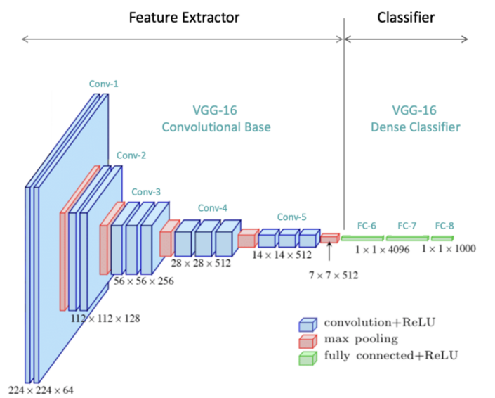
CNN Architecture
Convolutional Layer
Pooling Layer
Fully-connected Layer
https://learnopencv.com/understanding-convolutional-neural-networks-cnn/
Notes:
At a high level, CNN architectures contain an upstream feature extractor followed by a downstream classifier.

Slide 18
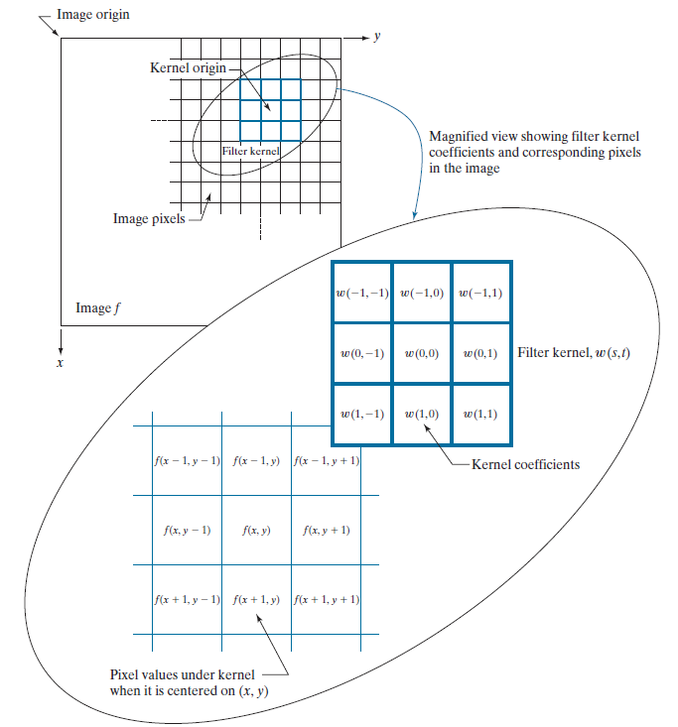

Convolutional Layer
Spatial convolution/linear spatial filtering

Slide 19
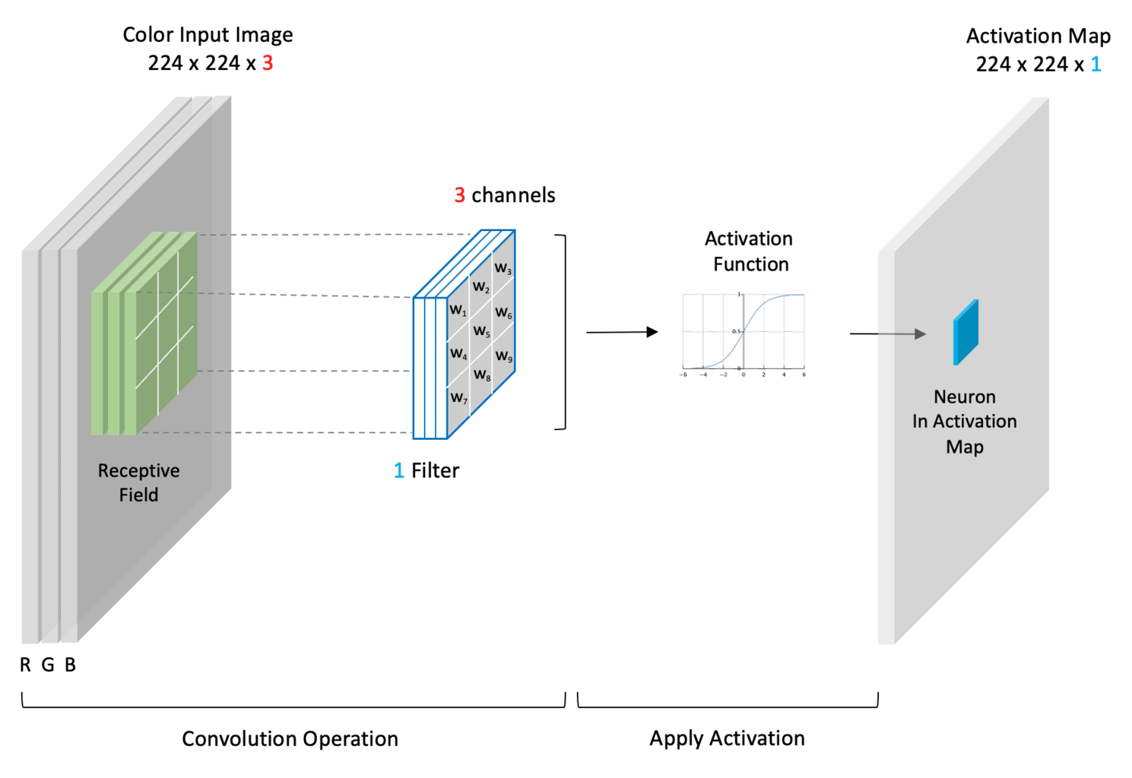
Convolutional Layer
https://learnopencv.com/understanding-convolutional-neural-networks-cnn/

Slide 20
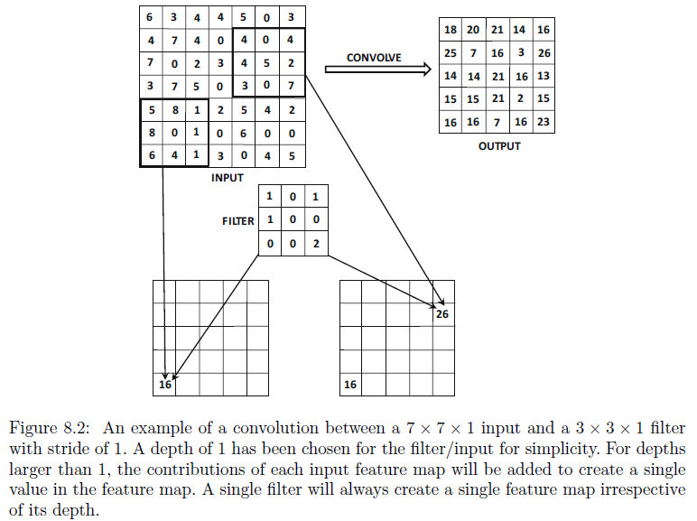
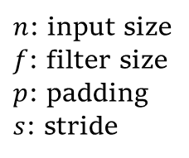
Convolutional Layer
$n$: input size
$f$: filter size
$p$: padding
$s$: stride
“Neural Networks and Deep Learning”, Aggarwal, C. C. , 2018.

Slide 21
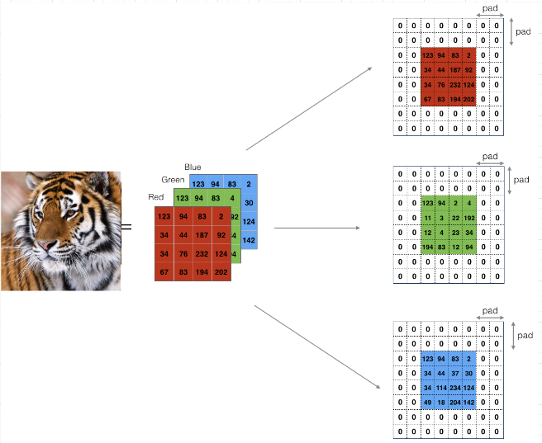
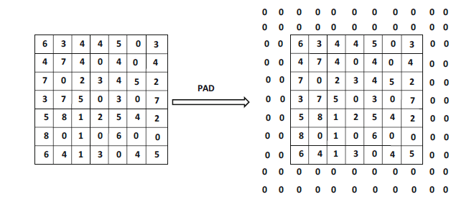
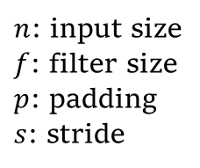
Convolutional Layer
$n$: input size
$f$: filter size
$p$: padding
$s$: stride
https://learnopencv.com/understanding-convolutional-neural-networks-cnn/
“Neural Networks and Deep Learning”, Aggarwal, C. C. , 2018.

Slide 22
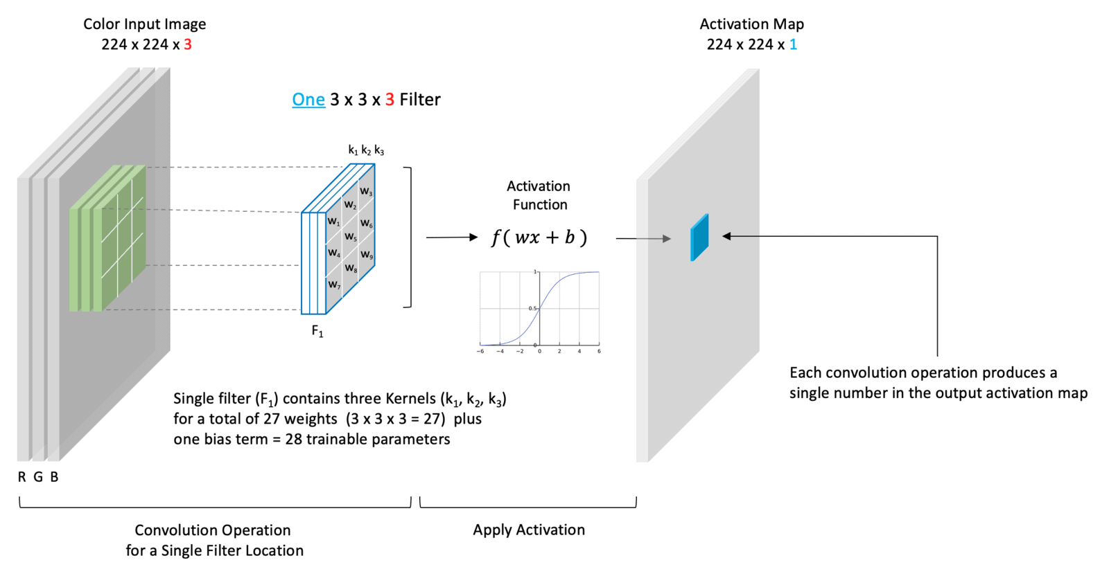
Convolutional Layer
n_filters * Dim_filter * n_channel
https://learnopencv.com/understanding-convolutional-neural-networks-cnn/c

Slide 23
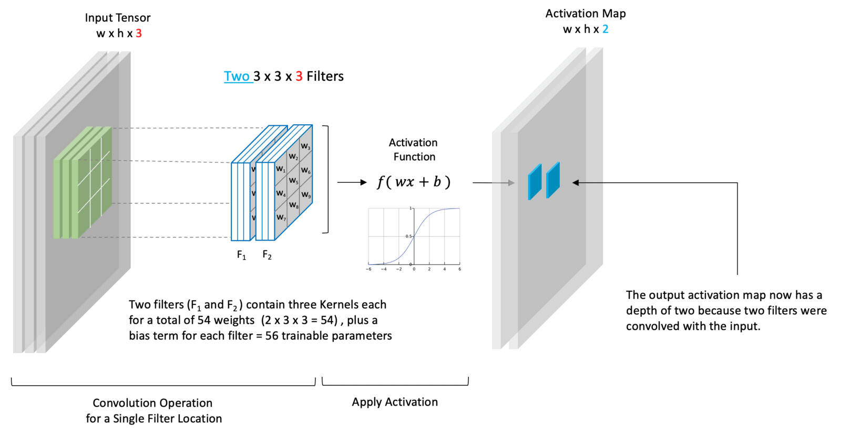
Convolutional Layer
n_filters * Dim_filter * n_channel
https://learnopencv.com/understanding-convolutional-neural-networks-cnn/c

Slide 24
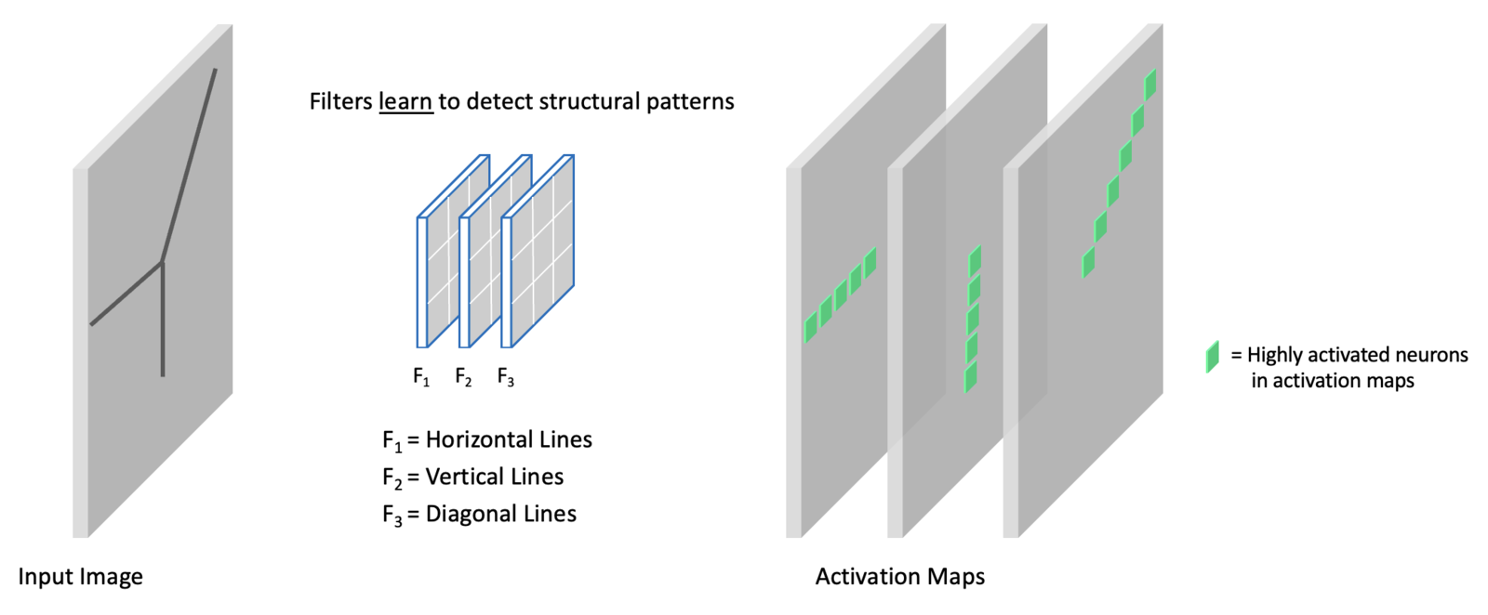
Convolutional Layer
https://learnopencv.com/understanding-convolutional-neural-networks-cnn/c

Slide 25
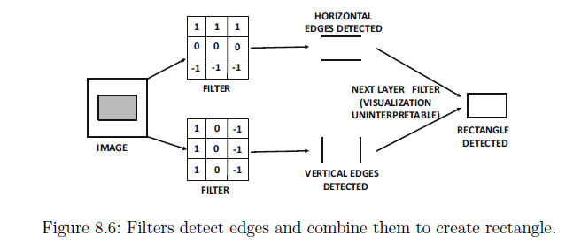
Convolutional Layer
“Neural Networks and Deep Learning”, Aggarwal, C. C. , 2018.

Slide 26
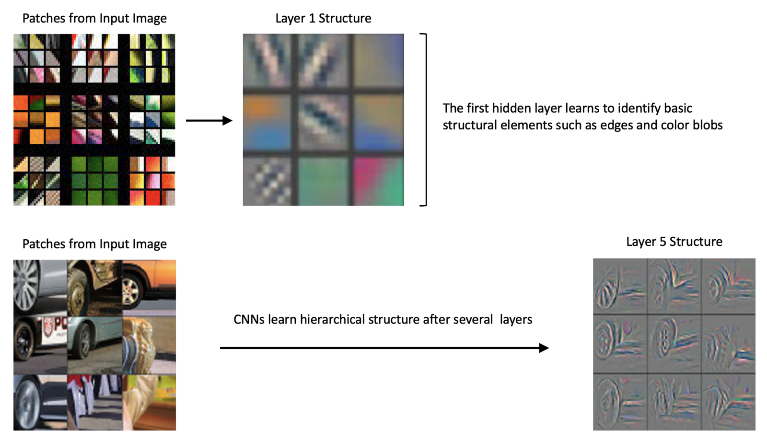
Convolutional Layer
Zeiler, M. D., & Fergus, R. (2014). Visualizing and understanding convolutional networks. In Computer Vision–ECCV 2014: 13th European Conference, Zurich, Switzerland, September 6-12, 2014, Proceedings, Part I 13 (pp. 818-833). Springer International Publishing.

Slide 27
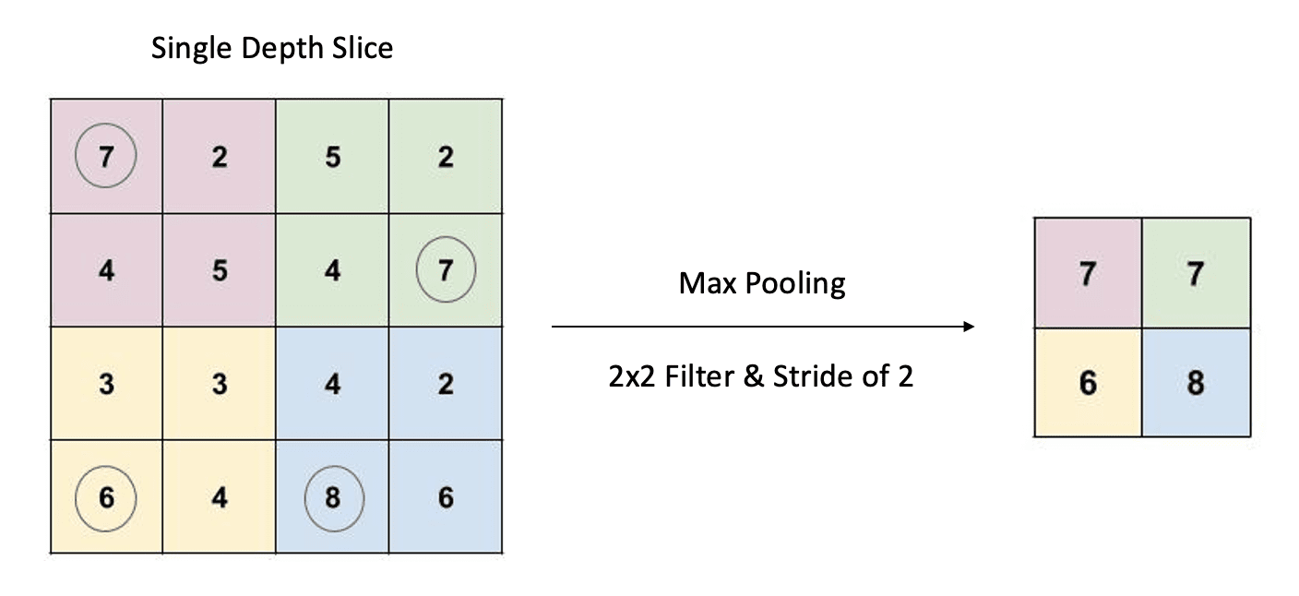
Pooling Layer
https://learnopencv.com/understanding-convolutional-neural-networks-cnn/c

Slide 28
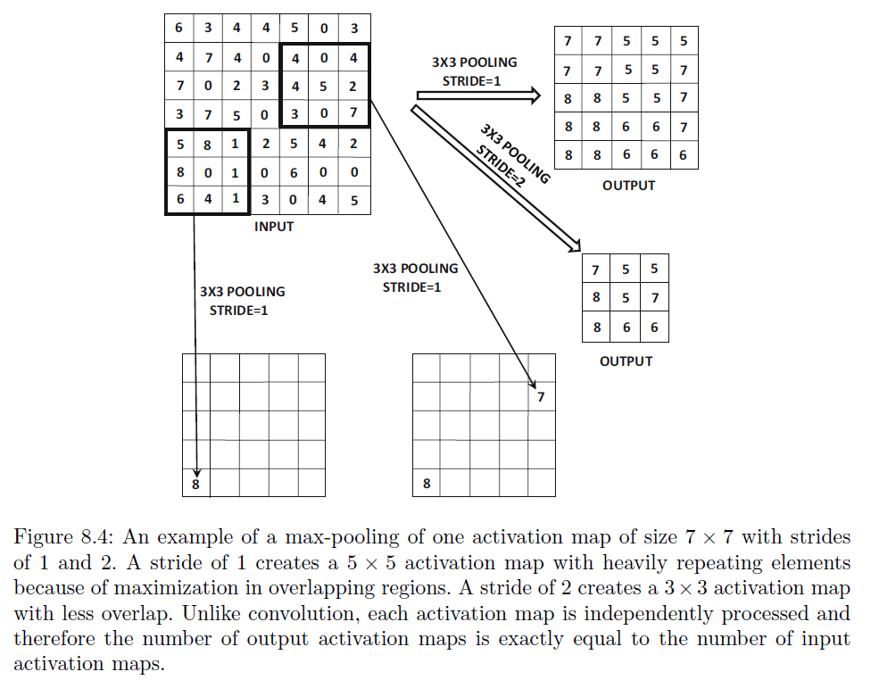
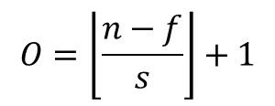
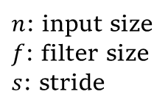
Pooling Layer
$$O=\left\lfloor \frac{n−f}{s}\right\rfloor +1$$
$n$: input size
$f$: filter size
$s$: stride

Slide 29
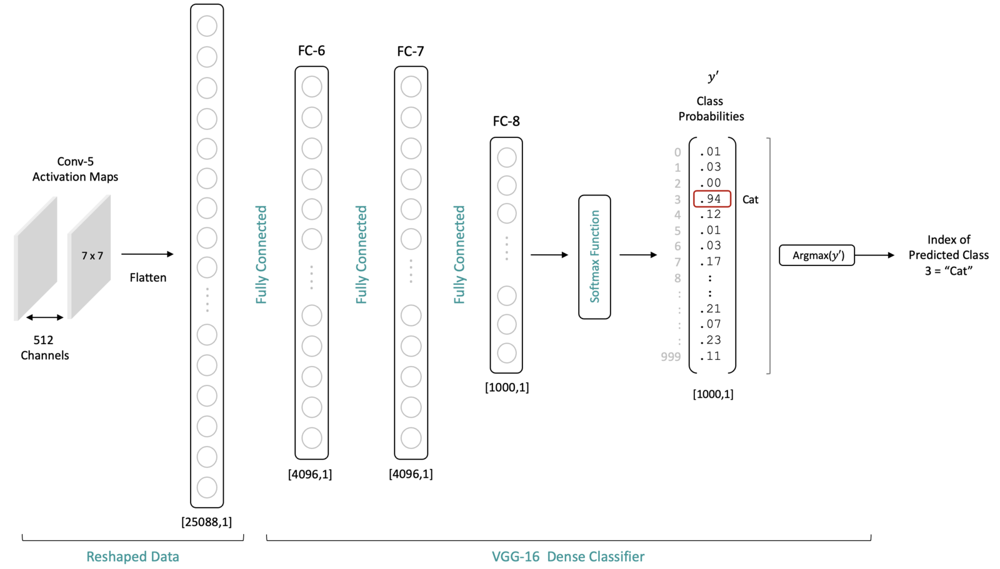
Fully-connected Layer
https://learnopencv.com/understanding-convolutional-neural-networks-cnn/

Slide 30
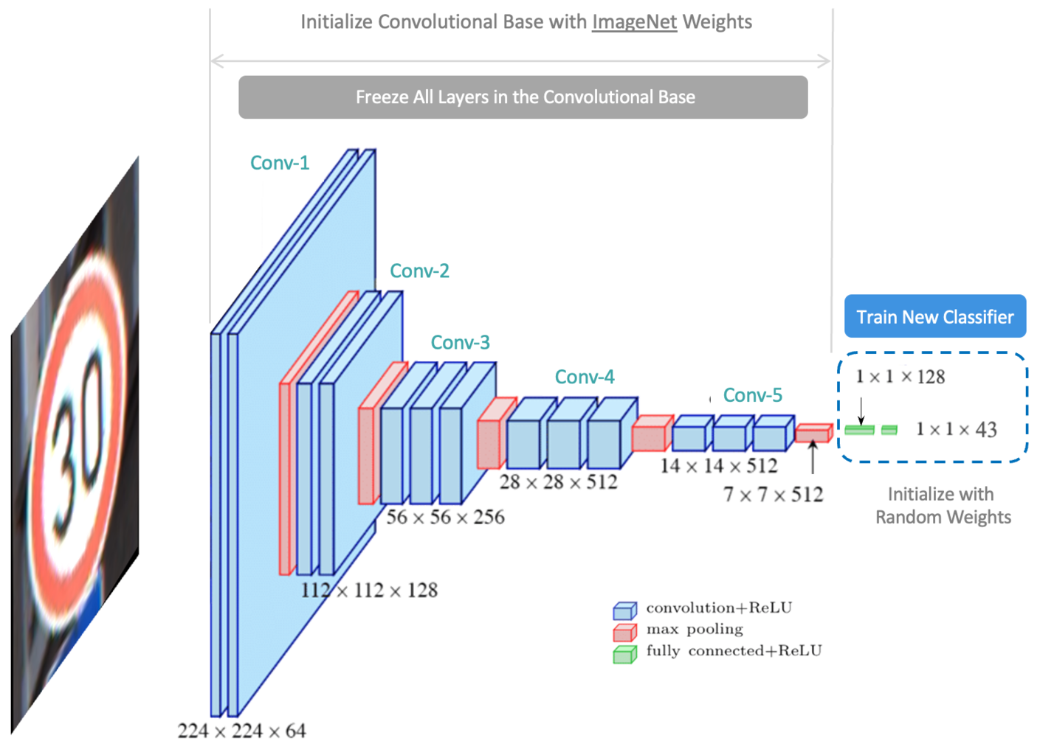
Transfer Learning & Fine-tuning
https://learnopencv.com/understanding-convolutional-neural-networks-cnn/

Slide 31
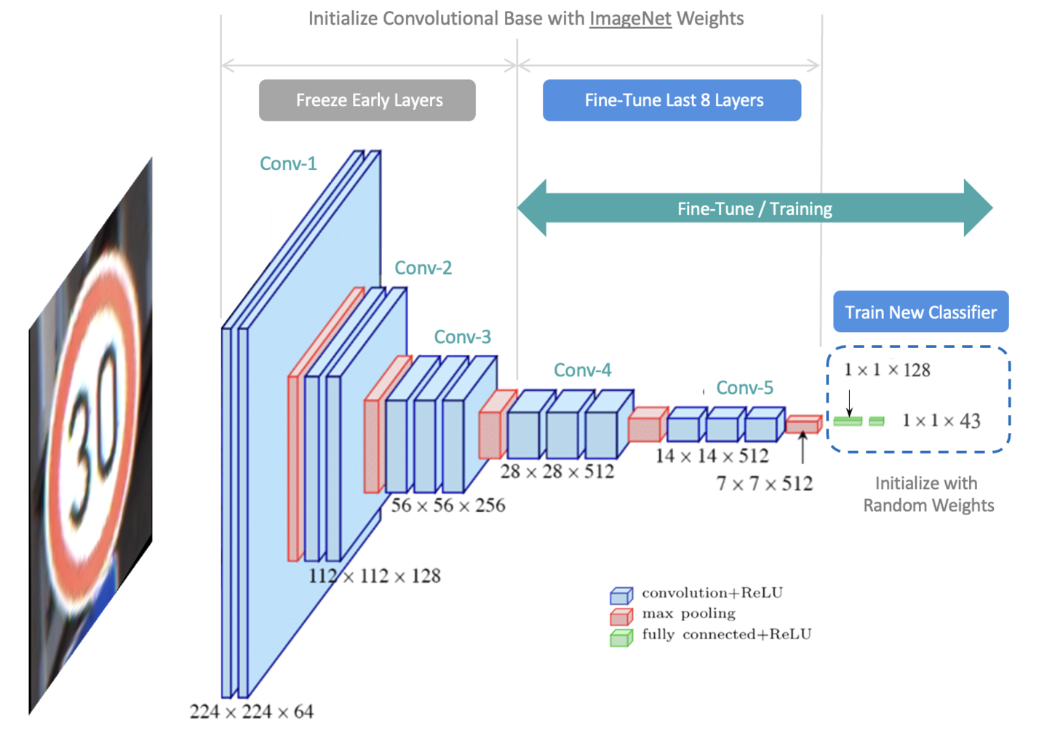
Transfer Learning & Fine-tuning
https://learnopencv.com/understanding-convolutional-neural-networks-cnn/

Slide 32
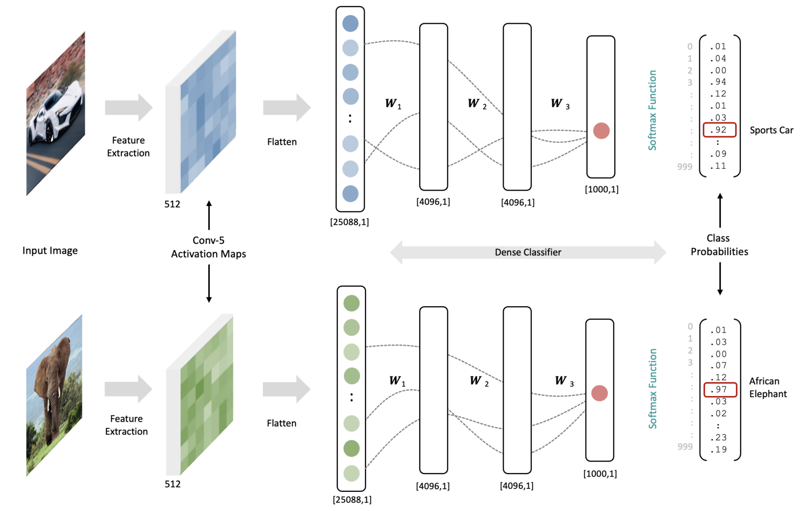
Intuition: Why CNNs work well
https://learnopencv.com/understanding-convolutional-neural-networks-cnn/c

Slide 33
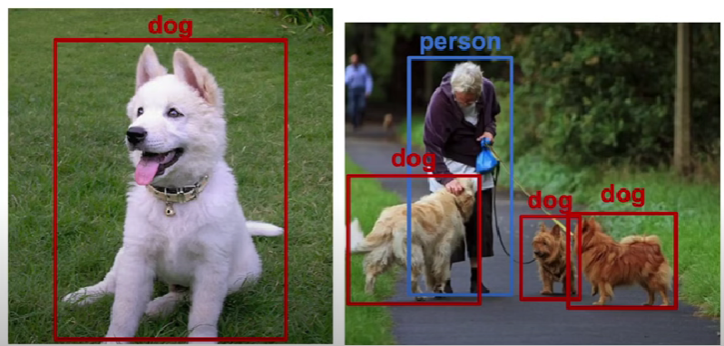
Object detection: Sliding Window Approach
https://youtu.be/26PWiWCz1v8?si=eWM5bksiEGVLCfVW
Notes:
Object detection not only classifies the image but also finds the bounding boxes around the objects. This method helps us understand what happens in a complex image, where multiple objects of interest are present.s the bounding boxes around the objects.

Slide 34
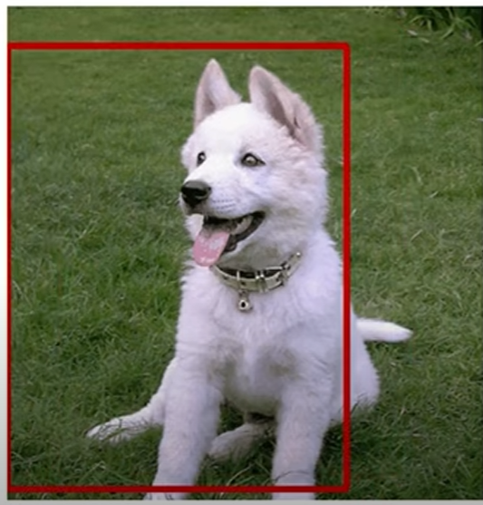
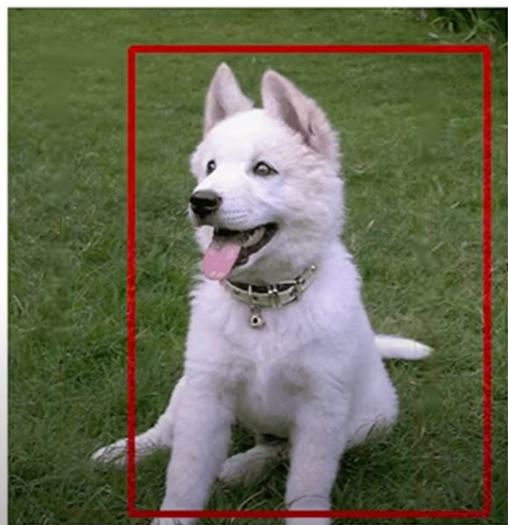
Sliding Window Approach
Classifier
Dog?
Classifier
Dog?
Computationally expensive and time consuming
Notes:
Sliding window approach generates a lot of windows. This method is computationally expensive and time consuming because the classification model has to run through each of them to predict whether or not the object is present.

Slide 35
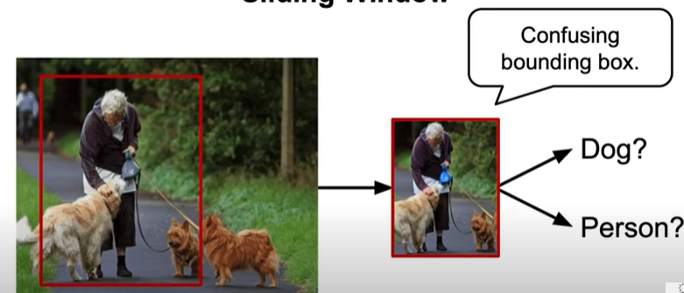
Sliding Window Approach
Notes:
If the objects are too small or too big for the sliding window, it becomes difficult for the method to capture the relevant objects. In the presence of multiple objects of interest, one bounding box may contain multiple objects, confusing the classification model.

Slide 36
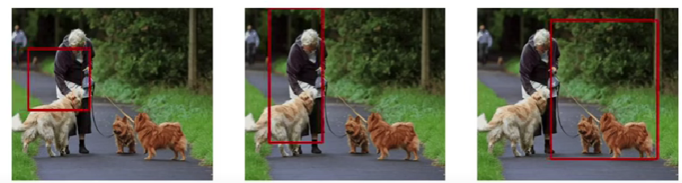
Sliding Window Approach
More classifications, leading to more computations
Notes:
One solution could be to use multiple sliding windows of different sizes that lead to more classifications, leading to more computations.

Slide 37
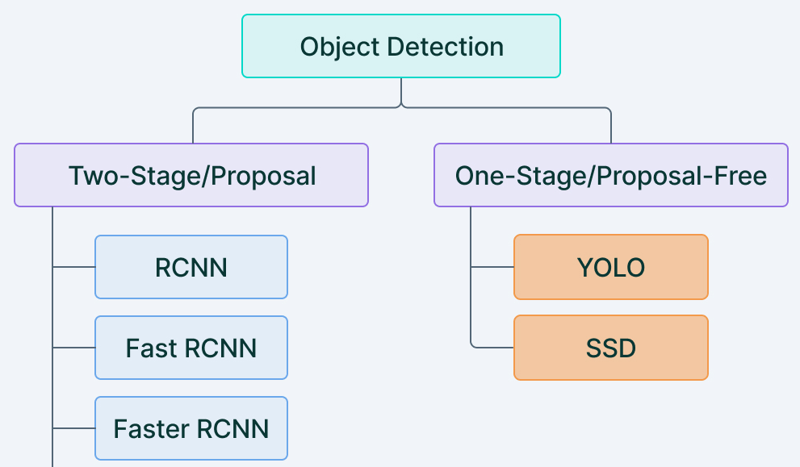
Deep Learning-based Approaches
https://www.google.com/
Notes:
Two-Stage Detectors perform the detection in two stages. In the first stage, the detectors propose candidate region and in the next stage, they classify the regions into categories. On the other hand, Single-stage detectors accurately forecast the bounding boxes and class probabilities for every area of the picture in a single pass.

Slide 38
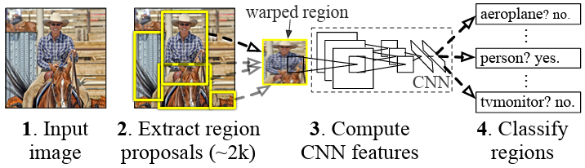
R-CNN (Regions with Convolutional Neural Networks)
Ross Girshick, Jeff Donahue, Trevor Darrell, and Jitendra Malik: 2013
Girshick, Ross, et al. "Rich feature hierarchies for accurate object detection and semantic segmentation."
Notes:
RCNN uses selective search algorithm to generate $2000$ region proposals from an image, then the proposed region is resized and passed through pre-trained CNN based models to extract feature vectors. Then, these feature vectors are fed to the classifier for classifying object within the region. This pioneering method for object detection combines region proposals with CNNs thereby bridging the gap between image classification and object detection. This work is the first to show that a CNN can lead to dramatically higher object detection performance.
R-CNN starts by generating region proposals using a method called selective search. These proposals are potential areas that might contain objects. This process identifies a set of candidate regions (or bounding boxes) in the image that are likely to contain objects. Typically, around 2000 category-independent region proposals are generated per image. Each region proposal is then resized to a fixed size and fed into a pre-trained CNN (such as AlexNet) to extract a fixed-length feature vector. A simple technique called affine image warping is used to compute a fixed-size CNN input from each region proposal, regardless of the region’s shape. The extracted feature vectors are then passed through a set of class-specific or category-specific linear SVMs to classify each region proposal into one of the object categories or as background. To refine the bounding box coordinates, a bounding box regression model is trained to predict the offset between the proposed region and the ground truth bounding box.

Slide 39
Region proposals
2000 category-independent region proposals per image
Initial small regions
Iterative merging
Hierarchical grouping
Set of region proposals
Girshick, Ross, et al. "Rich feature hierarchies for accurate object detection and semantic segmentation."
Notes:
The selective search algorithm starts by segmenting the image into many small regions to produce a set of initial regions, each representing a potential object part. These initial regions are then iteratively merged based on similarity measures, such as color, texture, size, and shape compatibility. The merging process continues until the entire image is represented by a single region. At each step, the most similar regions are merged, and the process is repeated at multiple scales to capture objects of different sizes. The algorithm performs hierarchical grouping t0 generate region proposals at different levels of granularity, from small parts to larger objects. The final output of selective search is a set of region proposals, each represented by a bounding box.

Slide 40
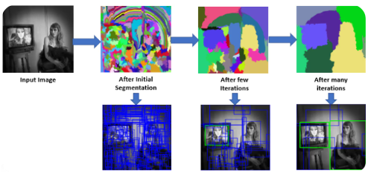
Region proposals
https://www.ultralytics.com/blog/what-is-r-cnn-a-quick-overview

Slide 41

Feature extraction
$$227 × 227×3$$
4096-dimensional
feature vector
AlexNet
Girshick, Ross, et al. "Rich feature hierarchies for accurate object detection and semantic segmentation."
Notes:
A 4096-dimensional feature vector is extracted from each region proposal using AlexNet CNN. Features are computed by forward propagating a mean-subtracted $227 × 227$ RGB image through the CNN. Regardless of the size or aspect ratio of the candidate region, all pixels are wrapped in a tight bounding box around it to the required size. Prior to warping, the size of each region proposal is expanded slightly to include $p=16$ pixels of additional context around the region to provide more surrounding information for better feature extraction.

Slide 42
Training
CNN for feature extraction
AlexNet: supervised pre-training + domain-specific fine-tuning (N+1-way classification)
SVM for category classification
Region specific binary classifier
Class-specific bounding-box regressor
Notes:
First, the CNN is pre-trained on a large auxiliary dataset (ILSVRC2012 classification) using image-level annotations only (bounding box labels are not available for this data). To adapt the CNN to the new task (detection) and the new domain (warped proposal windows), domain-specific fine-tuning is performed. Aside from replacing the CNN’s ImageNet specific 1000-way classification layer with a randomly initialized (N + 1)-way classification layer (where N is the number of object classes, plus 1 for background), the CNN architecture is unchanged.

Slide 43
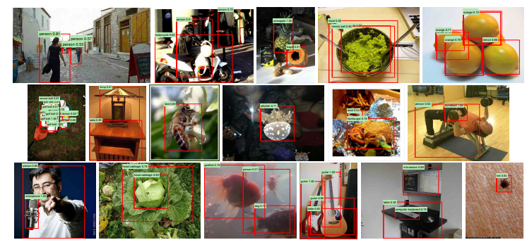
Results
53.7%: PASCAL VOC 2010-12 dataset
31.4%: ILSVRC2013 detection dataset
Girshick, Ross, et al. "Rich feature hierarchies for accurate object detection and semantic segmentation."
http://host.robots.ox.ac.uk/pascal/VOC/
Notes:
Two properties make detection efficient. First, all CNN parameters are shared across all categories. Second, the feature vectors computed by the CNN are low-dimensional when compared to other common approaches, such as bag-of-visual-word encodings. But R-CNN is computationally expensive and not very practical for real-time applications.

Slide 44
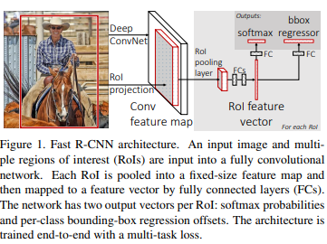
Fast R-CNN
Ross Girshick: 2015
CNN with RoI pooling layers
Integrated classification and regression approach
Girshick, Ross. "Fast r-cnn." arXiv preprint arXiv:1504.08083 (2015).
Notes:
Fast R-CNN is built on the R-CNN to efficiently classify object proposals using deep convolutional networks. It is an improvement over the original R-CNN method for object detection both in terms of training and testing speed and detection accuracy. This technique processes the complete image with the CNN to produce a feature map. Region of Interest (RoI) Pooling layers are used to extract the feature vector from the feature map. The technique utilizes an integrated classification and regression approach, it uses a single fully connected network to provide the output for both the class probabilities and bounding box coordinates.

Slide 45
Fast R-CNN
Recap of R-CNN:
R-CNN is slow
Fast R-CNN: Comparatively faster training and testing time than R-CNN
Notes:
R-CNN first fine-tunes a ConvNet on object proposals using log loss. Then, it fits SVMs to ConvNet features. These SVMs act as object detectors, replacing the softmax classifier learned by fine-tuning. In the third training stage, bounding-box regressors are learned. R-CNN is slow because it performs a ConvNet forward pass for each object proposal, without sharing computation.

Slide 46
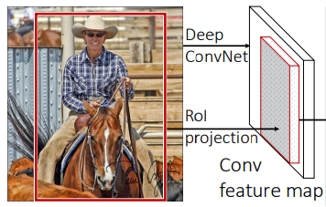
Convolutional Feature Extraction
Notes:
Unlike R-CNN, which processes each region proposal independently through the CNN, Fast R-CNN processes the whole image with several convolutional (conv) and max pooling layers to produce a conv feature map.

Slide 47
Region of Interest Pooling
Notes:
For each object proposal, a RoI pooling layer extracts a fixed-length feature vector from the feature map. RoI pooling ensures that each region proposal is mapped to a fixed-size feature map, regardless of its original size. The RoI pooling layer uses max pooling to convert the features inside any valid region of interest into a small feature map with a fixed spatial extent of $H × W$ (e.g., $7 × 7$), where $H$ and $W$ are layer hyper-parameters that are independent of any particular RoI.

Slide 48
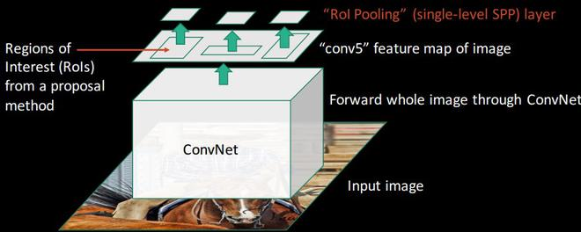
Region of Interest Pooling
https://www.geeksforgeeks.org/fast-r-cnn-ml/

Slide 49
Region of Interest Pooling
RoI pooling layer uses max pooling
$(r, c, h, w)$
$$h×w×n ⇒H×W×n$$
$$14×14×n ⇒7×7×n$$

Slide 50
Convolutional Neural Network
AlexNet
VGG16
VGG_CNN_M_1024
Notes:
The authors have used three different pre-trained CNNs: AlexNet, VGG16, and a variant of VGGNet called VGG_CNN_M_1024 and fine-tuned them.

Slide 51
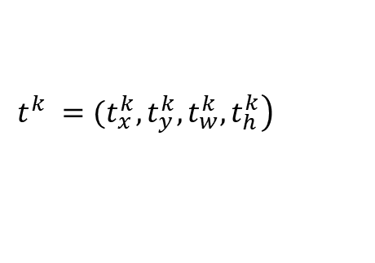
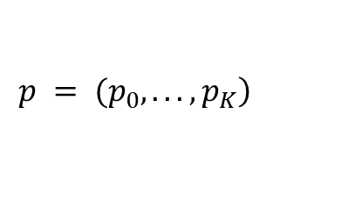
Convolutional Neural Network
$$\left.p = (p_{0}, . . . , p_{K}\right)$$
$$\left.t^{k} =(t_{x}^{k}, t_{y}^{k}, t_{w}^{k}, t_{h}^{k}\right)$$
VGG16
Last max pooling layer is replaced by RoI pooling layer
Last fully connected layer and softmax are replaced with the two sibling layers
Two data inputs: a list of images and a list of RoIs in those images
Notes:
When a pre-trained network initializes a Fast R-CNN network, it undergoes three transformations. First, the last max pooling layer is replaced by a RoI pooling layer. Second, the network’s last fully connected layer and softmax (which were trained for 1000-way ImageNet classification) are replaced with the two sibling layers (a fully connected layer and softmax over $K + 1$ categories and category-specific bounding-box regressors). Third, the network is modified to take two data inputs: a list of images and a list of RoIs in those images.

Slide 52

Training
Feature sharing during training
RoIs from the same image share computation and memory
Jointly optimizes a softmax classifier and bounding-box regressors
Multi-task loss function
Notes:
Fast R-CNN uses a multi-task loss function that combines classification loss and bounding box regression loss to simultaneously optimize for both tasks and improve overall performance.

Slide 53
Comparison with R-CNN
53.7%: PASCAL VOC 2010-12
R-CNN
mAP 65.7%: VOC12
mAP 66.1%: VOC10
Fast R-CNN
9X faster during training
213X faster during inference

Slide 54
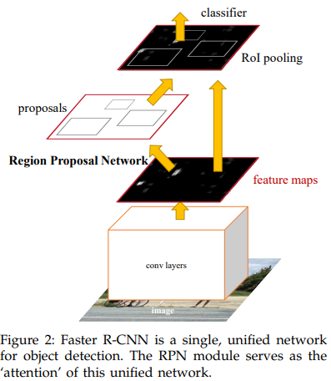
Faster R-CNN
Shaoqing Ren, Kaiming He, Ross Girshick, and Jian Sun: 2015
Region Proposal Network with CNN
Fast R-CNN detector
RPN: Reduces the number of regions that need processing
Ren, Shaoqing, et al. "Faster R-CNN: Towards real-time object detection with region proposal networks."
Notes:
Faster R-CNN, introduced by Shaoqing Ren, Kaiming He, Ross Girshick, and Jian Sun in 2015, is composed of two modules; a fully convolutional network that proposes regions, and the Fast R-CNN detector that uses the proposed regions. The RPN predicts the object bounds from the feature maps created by the convolutional layers. Then, the features of the proposed region generated by RPN are pooled using ROI Pooling and fed into a network that predicts the class and bounding box.

Slide 55
Faster R-CNN
Recap of Fast R-CNN:
Notes:
The two-stage approach allows for more efficient object detection than other R-CNNs as the RPN reduces the number of regions that need to be processed by the CNN classifier.

Slide 56
Region Proposal Network
Predicts the object bounds from the convolutional feature maps
Reduces the number of regions that need to be processed by the classifier
Object Proposals
Input Image
Conv Layers
RPN
Objectness Score
ZFNet
VGG-16
Zeiler, Matthew D., and Rob Fergus. "Visualizing and understanding convolutional networks."
Simonyan, Karen, and Andrew Zisserman. "Very deep convolutional networks for large-scale image recognition." arXiv preprint arXiv:1409.1556 (2014).
Notes:
The RPN takes an image (of any size) as input and outputs a set of rectangular object proposals, each with an objectness score. The RPN is a fully convolutional network that generates region proposals directly from the feature maps produced by the Conv layers.

Slide 57


Region Proposal Network
box-classification
box-regression
$1 × 1$ conv layer
$n×n$ conv layer
$n × n$ spatial window
Ren, Shaoqing, et al. "Faster R-CNN: Towards real-time object detection with region proposal networks."
Notes:
To generate region proposals, a small network is slid over the convolutional feature map output by the last shared convolutional layer. This small network takes as input an $n × n$ spatial window of the input convolutional feature map. Each sliding window is mapped to a lower-dimensional feature (256-d for ZF and 512-d for VGG, followed by ReLU activation function). This feature is fed into two sibling fully-connected layers—a box-regression layer (reg) and a box-classification layer (cls). Because the network operates in a sliding-window fashion, the intermediate layer, cls layer and reg layer are shared across all spatial locations. This architecture is naturally implemented with an n×n convolutional layer followed by two sibling 1 × 1 convolutional layers (for reg and cls, respectively).
At each sliding-window location, we simultaneously predict multiple region proposals, where the number of maximum possible proposals for each location is denoted as k. So the reg layer has 4k outputs encoding the coordinates of k boxes, and the cls layer outputs 2k scores that estimate probability of object or not object for each proposal. The k proposals are called anchors. An anchor is centered at the sliding window in question, and is associated with a scale and aspect ratio. By default, we use 3 scales and 3 aspect ratios, yielding k = 9 anchors at each sliding position. For a convolutional feature map of a size W × H, there are WHk anchors in total.

Slide 58

Object Detector
The detector is a Fast R-CNN network
Classification layer
Bounding box regression layer
Multi-task loss function
Notes:
The classification layer assigns a class label to each region proposal, while the bounding box regression layer refines the coordinates of the bounding boxes. Faster R-CNN is also trained end-to-end using a multi-task loss function that combines classification loss and bounding box regression loss. This allows the network to simultaneously optimize for both tasks, improving overall performance.

Slide 59
Training
4-step training algorithm
RPN is trained end-to-end
Fast R-CNN is trained using the proposals generated by the RPN
Initialize RPN with Fast R-CNN weights and fine-tune the layers unique to RPN
Fine-tune the unique layers of Fast R-CNN
Notes:
The Faster R-CNN adopts a pragmatic 4-step training algorithm to learn shared features via alternating optimization. In the first step, the RPN is trained end-to-end by backpropagation and SGD using mini-batches. This network is initialized with an ImageNet-pre-trained model and fine-tuned end-to-end for the region proposal task. In the second step, we train a separate detection network by Fast R-CNN (includes conv layers, RoI pooling, and simultaneous classifier and regressor) using the proposals generated by the RPN in the first step. This detection network is also initialized by the ImageNet-pre-trained model. At this point, the two networks do not share convolutional layers. In the third step, we initialize RPN using the detector weights, but we fix the shared convolutional layers and only fine-tune the layers unique to RPN. Now the two networks share convolutional layers. Finally, keeping the shared convolutional layers fixed, we fine-tune the unique layers of Fast R-CNN. As such, both networks share the same convolutional layers and form a unified network.

Slide 60

Results
73.2% mAP: VOC 2007 test set
Ren, Shaoqing, et al. "Faster R-CNN: Towards real-time object detection with region proposal networks."
http://host.robots.ox.ac.uk/pascal/VOC/

Slide 61

Results
42.7% mAP@0.5: MS COCO test-dev set
Ren, Shaoqing, et al. "Faster R-CNN: Towards real-time object detection with region proposal networks."
https://cocodataset.org/#home

Slide 62
Comparison with R-CNN and Fast R-CNN
Faster R-CNN
R-CNN
mAP 70.4%: VOC 2012
53.7%: PASCAL VOC 2010-12
Fast R-CNN
mAP 65.7%: VOC12
mAP 66.1%: VOC10

Slide 63
Comparison with R-CNN and Fast R-CNN
 | R-CNN | Fast R-CNN | Faster R-CNN
Region Proposals | Selective Search | Selective Search | Region Proposal Network
Feature Sharing | No | Shared for the entire image | Shared for the entire image
Classification | SVMs | Integrated into the network | Integrated into the network
Bounding Box Regression | Separate step | Integrated into the network | Integrated into the network
Speed | Slow | Fast | Faster

Slide 64
Single Shot MultiBox Detector
Liu et al, 2016
Input Image
SSD
NMS
Bounding Boxes
and Scores
Final Detections
Liu, Wei, et al. "Ssd: Single shot multibox detector." Computer Vision–ECCV 2016
Notes:
The Single Shot MultiBox Detector (SSD) is a one-stage object detection architecture that detects objects in images using a single deep neural network. It discretizes the output space of bounding boxes into a set of default boxes over different aspect ratios and scales per feature map location. At prediction time, the network generates scores for the presence of each object category in each default box and produces adjustments to the box to better match the object shape.
The method is called “single shot” because it detects objects in one pass of the CNN without needing region proposals or multiple processing stages. The “MultiBox” component refers to the ability of the method to predict multiple bounding boxes for each object, allowing for more accurate localization.

Slide 65
Single Shot MultiBox Detector
Base Network
Auxiliary structure
Multi-scale feature maps for detection
Convolutional predictors for detection
Default boxes and aspect ratios
Notes:
The SSD architecture is based on a feed-forward CNN. It consists of a Base Network that is typically, a pre-trained network like VGG16 to extract feature maps. Additional convolutional layers are added on top of the base network to detect objects at multiple scales.
Multi-scale feature maps for detection: Convolutional feature layers are added to the end of the truncated base network. These layers decrease in size progressively and allow predictions of detections at multiple scales.
Convolutional predictors for detection: Each added feature layer (or optionally an existing feature layer from the base network) can produce a fixed set of detection predictions using a set of convolutional filters.
Default boxes and aspect ratios: We associate a set of default bounding boxes with each feature map cell, for multiple feature maps at the top of the network. For each box out of $k$ at a given location, we compute $c$ class scores and the $4$ offsets relative to the original default box shape. This results in a total of $(c + 4)k$ filters that are applied around each location in the feature map, yielding $(c + 4)kmn$ outputs for a $m× n$ feature map.

Slide 66

Single Shot MultiBox Detector
Base Network: VGG16, which is pre-trained on the ILSVRC CLS-LOC dataset
$300×300$input size
$(c + 4)kmn$ outputs for a $m× n$ feature map
Russakovsky, O., Deng, J., Su, H., Krause, J., Satheesh, S., Ma, S., Huang, Z., Karpathy, A., Khosla, A., Bernstein, M., Berg, A.C., Fei-Fei, L.: Imagenet large scale visual recognition challenge.
https://image-net.org/challenges/LSVRC/2017/
Notes:
The above figure shows the architecture details of the SSD300 model that takes an input image of dimension $300×300$. Our experiments are all based on VGG16, which is pre-trained on the ILSVRC CLS-LOC dataset. We convert fc6 and fc7 to convolutional layers, subsample parameters from fc6 and fc7, change pool5 from $2×2$, $s2$ to $3×3$, $s1$. We remove all the dropout layers and the fc8 layer. We use conv4_3, conv7 (fc7), conv8_2, conv9_2, conv10_2, and conv11_2 to predict both location and confidences. For conv4_3, conv10_2 and conv11_2, we only associate 4 default boxes at each feature map location. For all other layers, we put 6 default boxes.

Slide 67

Single Shot MultiBox Detector
The overall loss function is a weighted sum of the localization loss and the confidence loss.
N is the number of matched default boxes
Utilizes feature maps from several different layers in a single network
handles different object scales
shares parameters across all object scales
Notes:
The SSD training objective can handle multiple object categories. The overall loss function is a weighted sum of the localization loss (loc) and the confidence loss (conf).

Slide 68

Single Shot MultiBox Detector

Slide 69

Single Shot MultiBox Detector
Lin, Tsung-Yi, et al. "Microsoft coco: Common objects in context." Computer Vision–ECCV 2014

Slide 70
Comparison with Faster R-CNN
SSD
74.3% mAP on VOC2007 test
59 FPS on a Nvidia Titan Xand for $512×512$ input
Faster R-CNN
mAP of 73.2% VOC2007 test dataset
7 FPS

Slide 71

YOLO (You Only Look Once)
Using YOLO, you only look once at an image to predict what objects are present and where they are.
$$448×448$$
Redmon, Joseph, et al. "You only look once: Unified, real-time object detection." Proceedings of the IEEE conference on computer vision and pattern recognition. 2016.
Notes:
YOLO, or You Only Look Once is a state-of-the-art, real-time object detection algorithm known for its speed and accuracy. It provides very accurate object detection in real time by dividing the input picture into a grid and predicting bounding boxes and class probabilities for each grid cell. YOLO performs object detection as a single regression problem, straight from image pixels to bounding box coordinates and class probabilities. Using YOLO, you only look once at an image to predict what objects are present and where they are.

Slide 72

YOLO (You Only Look Once)
Extremely fast
Reasons globally about the image
Learns generalizable representations of objects
Predicts all bounding boxes across all classes for an image simultaneously
Redmon, Joseph, et al. "You only look once: Unified, real-time object detection." Proceedings of the IEEE conference on computer vision and pattern recognition. 2016.
Notes:
This unified model has several benefits over traditional methods of object detection. First, YOLO is extremely fast. Since we frame detection as a regression problem we don’t need a complex pipeline. We simply run our CNN on a new image at test time to predict detections. Second, YOLO reasons globally about the image when making predictions. Unlike sliding window and region proposal-based techniques, YOLO sees the entire image during training and test time so it implicitly encodes contextual information about classes as well as their appearance. Third, YOLO learns generalizable representations of objects. When trained on natural images and tested on artwork, YOLO outperforms top detection methods like R-CNN by a wide margin. Since YOLO is highly generalizable, it is less likely to break down when applied to new domains or unexpected inputs.

Slide 73
YOLO (You Only Look Once)
Divides the input image into an $S×S$ grid
Each grid cell predicts $B$ bounding boxes, corresponding confidence scores
$(x, y, w, h$, confidence)
Confidence: $Pr\left(Object\right)∗{IOU}_{pred}^{truth}$
center of the box relative to the bounds of the grid cell
width and height are predicted relative to the whole image
and Conditional class probabilities, $Pr({Class}_{i}|Object)$
Testing/Inference
Class-specific confidence scores
$$Pr\left({Class}_{i} | Object\right)∗ Pr\left(Object\right)∗{IOU}_{pred}^{truth}=Pr\left({Class}_{i}\right)∗{IOU}_{pred}^{truth}$$
Notes:
Our system divides the input image into an S×S grid. If the center of an object falls into a grid cell, that grid cell is responsible for detecting that object. Each grid cell predicts B bounding boxes and confidence scores for those boxes. These confidence scores reflect how confident the model is that the box contains an object and also how accurate it thinks the box is that it predicts. Formally we define confidence as Pr(Object)*〖IOU〗_pred^truth. If no object exists in that cell, the confidence scores should be zero. Otherwise we want the confidence score to equal the intersection over union (IOU) between the predicted box and the ground truth. Each bounding box consists of 5 predictions: x,y,w,h, and confidence. The (x,y) coordinates represent the center of the box relative to the bounds of the grid cell. The width and height are predicted relative to the whole image. Finally, the confidence prediction represents the IOU between the predicted box and any ground truth box.
Each grid cell also predicts C conditional class probabilities, Pr(〖Class〗_i |Object). These probabilities are conditioned on the grid cell containing an object. We only predict one set of class probabilities per grid cell, regardless of the number of boxes B. At test time we multiply the conditional class probabilities and the individual box confidence predictions, Pr(〖Class〗_i│Object)* Pr(Object)*〖IOU〗_pred^truth=Pr(〖Class〗_i )*〖IOU〗_pred^truth which gives us class-specific confidence scores for each box. These scores encode both the probability of that class appearing in the box and how well the predicted box fits the object.

Slide 74

YOLO (You Only Look Once)
2 bounding boxes per cell, each with 5 predictions (4 coordinates + 1 confidence score) = 2 * 5 = 10
20 class probabilities for each cell
$7×7×30$ tensor predictions
Redmon, Joseph, et al. "You only look once: Unified, real-time object detection." Proceedings of the IEEE conference on computer vision and pattern recognition. 2016.
http://host.robots.ox.ac.uk/pascal/VOC/
Notes:
We implement this model as a CNN and evaluate it on the PASCAL VOC detection dataset. The initial convolutional layers of the network extract features from the image while the fully connected layers predict the output probabilities and coordinates. Our network architecture is inspired by the GoogLeNet model for image classification. Our network has 24 convolutional layers followed by 2 fully connected layers. Detection often requires fine-grained visual information so we increase the input resolution of the network from $224 × 224$ to $448 × 448$. The final output of our network is the $7×7×30$ tensor of predictions.

Slide 75

YOLO (You Only Look Once)
VOC 2012 test set: 57.9% mAP.
Redmon, Joseph, et al. "You only look once: Unified, real-time object detection." Proceedings of the IEEE conference on computer vision and pattern recognition. 2016.
Notes:
YOLO still lags behind state-of-the-art detection systems in accuracy. While it can quickly identify objects in images it struggles to precisely localize some objects, especially small ones.

Slide 76
Comparison with SSD
 | SSD (Single Shot MultiBox Detector) | YOLO (You Only Look Once)
Architecture | Uses a feed-forward convolutional network with additional convolutional layers for multi-scale feature maps | Uses a single convolutional network inspired by GoogLeNet, with 24 convolutional layers followed by 2 fully connected layers
Speed | Very fast, suitable for real-time applications | Faster than SSD, capable of real-time Processing
Accuracy | High accuracy, especially for objects of varying sizes due to multi-scale feature maps | High accuracy, but may struggle with small objects compared to SSD
Grid Division | Does not use a fixed grid; instead, predicts bounding boxes at multiple scales | Divides the input image into a fixed grid and predicts bounding boxes for each grid cell
Bounding Boxes | Predicts fixed number of default boxes for each feature map location, refined during training | Each grid cell predicts a fixed number of bounding boxes and their confidence scores
Class Probabilities | Predicts class probabilities for each default box | Predicts class probabilities for each grid cell
Non-Maximum Suppression | Applies NMS to remove redundant bounding boxes with low confidence scores | Applies NMS to remove overlapping bounding boxes with lower confidence scores

Slide 77
Evolution of YOLO Models
YOLOv1: Introduced in 2015
YOLOv2 (YOLO9000): Improved accuracy and speed, introduced batch normalization and anchor boxes.
YOLOv3: Enhanced with multi-scale predictions and better performance on small objects.
YOLOv4 and beyond: Further improvements in speed and accuracy

Slide 78
References
“Deep Learning”, An MIT Press book, Ian Goodfellow and Yoshua Bengio and Aaron Courville, http://www.deeplearningbook.org
https://onlinecourses.nptel.ac.in/noc22_cs124/preview
“Neural Networks and Deep Learning”, Aggarwal, C. C. , 2018.
Girshick, Ross, et al. “Rich feature hierarchies for accurate object detection and semantic segmentation.”
Girshick, Ross. “Fast r-cnn.” arXiv preprint arXiv:1504.08083 (2015).
Ren, Shaoqing, et al. “Faster R-CNN: Towards real-time object detection with region proposal networks.”
Liu, Wei, et al. “Ssd: Single shot multibox detector.” Computer Vision–ECCV 2016
Redmon, Joseph, et al. “You only look once: Unified, real-time object detection.” Proceedings of the IEEE conference on computer vision and pattern recognition. 2016.

Slide 79
Thank You

